Slide 1
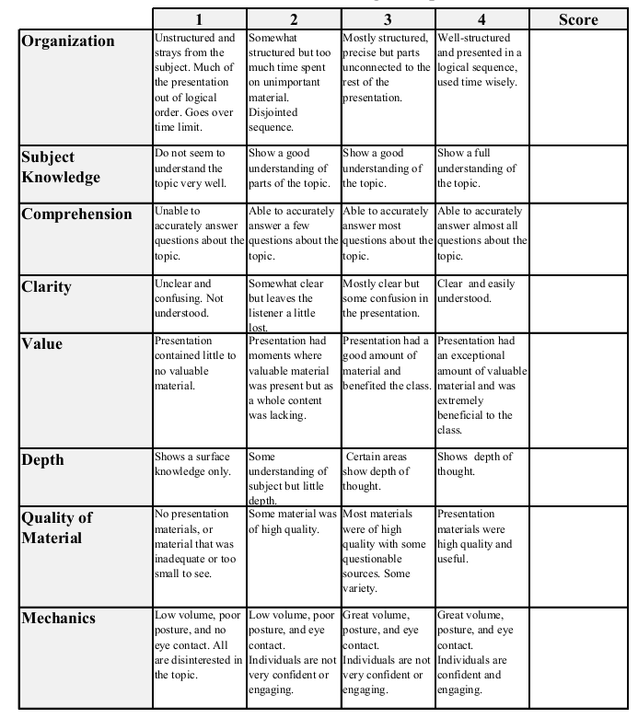
Final Presentation: Econ 339 Michelle Asamoah December 4, 2014
Racial Segregation and Quality of Care Disparity in US Nursing Homes

Slide 2
Racial Disparities in Healthcare
There are significant racial inequalities or disparities in healthcare in the United States
People of different races are mostly likely to receive care from a different set of providers.
There are many factors that contribute to the racial disparities in health care in the United States
Geographical differences in the quality of providers perpetuate racial disparities in healthcare

Slide 3

Nursing Home Segregation and Disparities
In the United States Nursing homes are more segregated than residential neighborhoods.
Most nursing home residents are elderly people who enter the facility after being a patient at a hospital.
Racial segregation and racial disparities often begins when the patient and their loved ones are choosing the nursing home facility.

Slide 4
Descriptive statistics of treating nursing home characteristics
Variable | White Average | Black Average
Distance from Residential Zip Code (in Kilometers) | 15.81 | 13.18
Distance from Originating Hospital (in Kilometers) | 12.30 | 9.38
Percent of residents that are black | 6.66 | 35.22
Number of RNs per Bed | .115 | .098
Total Number of Beds | 118.41 | 139.71
Occupancy Rate | .85 | .86

Slide 5
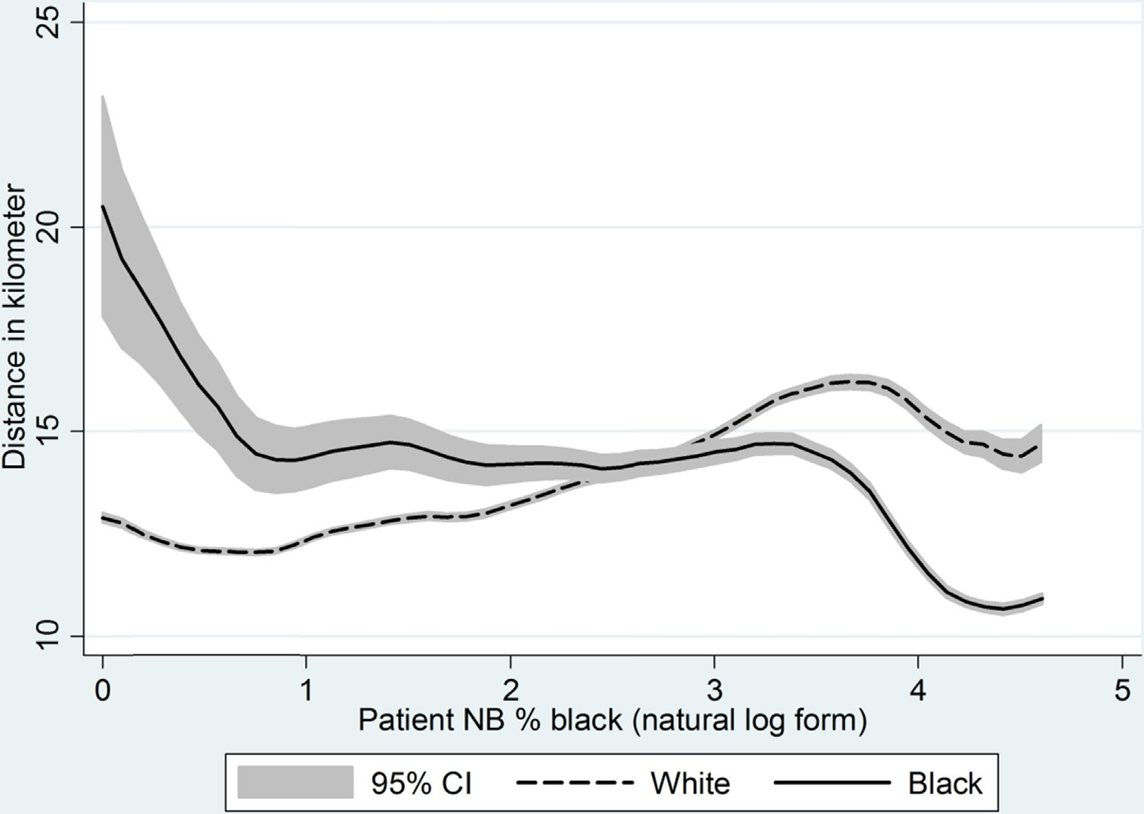
How far will they go?

Slide 6
Conclusion
There is a high degree of segregation in the nursing home industry and a difference in the quality of care of patients of different races
African Americans from predominately white neighborhoods will travel to a nursing home with more black people and a lower quality of care
Policy interventions is the most effective way to make positive changes to the racial segregation and disparities in quality of care

Slide 7
Reference
Rahman, M., & Foster, A. D. (2014). Racial segregation and quality of care disparity in US nursing homes.
Providence: Journal of Health Economics.

